Slide 1
Modern Data Architecture Solution in HDFC Bank
Current Challenges in Merchant Business Unit due to legacy system:
Data Volume: 15-20 GB daily data ingestion in local NAS Drive
Scalability Issues in Business Intelligence Unit (BIU)
Performance bottlenecks in existing infrastructure
Growing storage requirements
Limited data processing capabilities

Slide 2
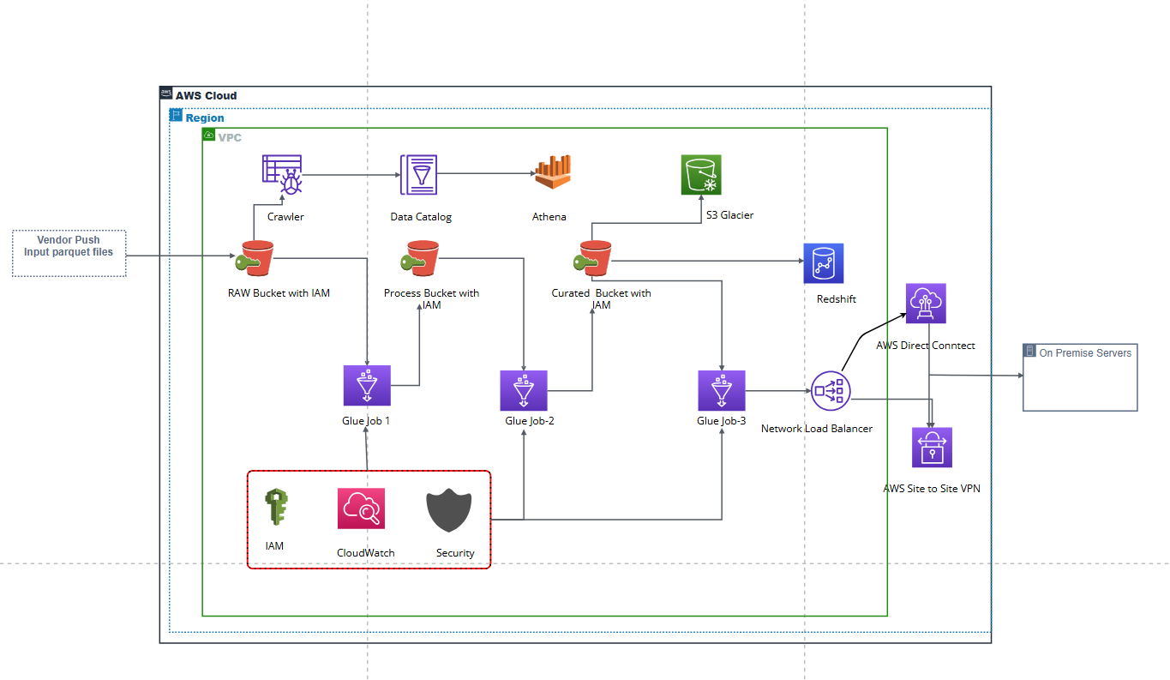
Architecture Diagram

Slide 3
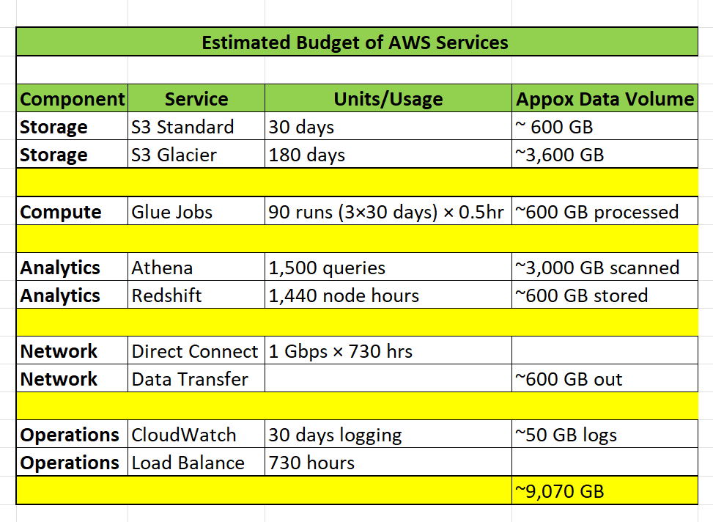
Estimated Cost Analysis and Benefits
Key Insights:
- Redshift will be costly
- Network costs are second highest at ~15%
- Compute (Glue)
- Storage costs are minimal
Top Cost Optimization Targets:
🎯 Redshift sizing optimization
⚙️ Glue job efficiency
💾 Storage lifecycle management

